Slide 1
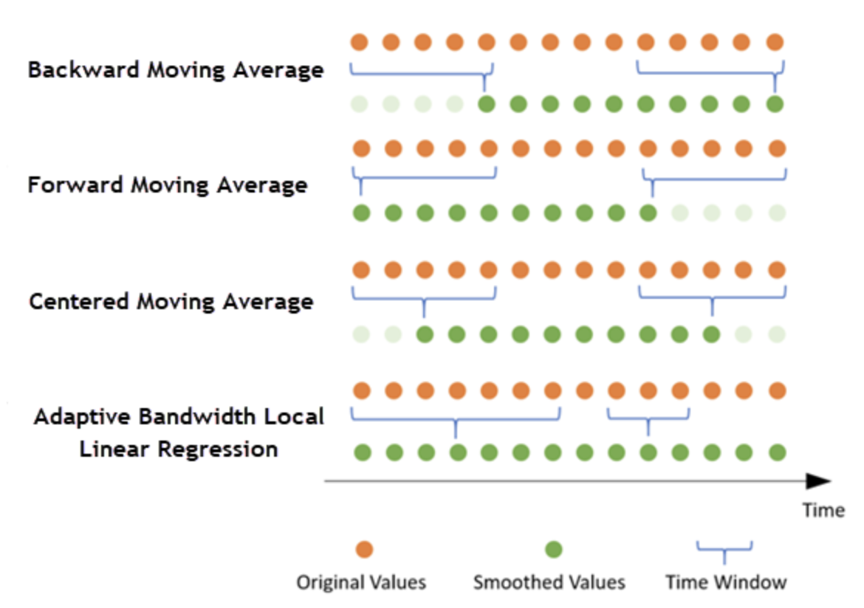
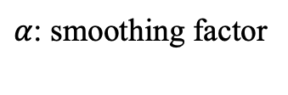
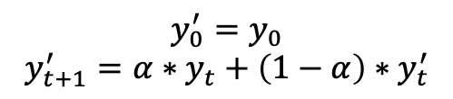
Time-series data smoothing
degree | Transductive AUC | Transductvie AP | Inductive AUC | Inductive AP
No Smoothing | 0.9781 | 0.9793 | 0.9729 | 0.9744
Backward Average | 0.9670 | 0.9709 | 0.9626 | 0.9660
Centered Smooth | 0.9695 | 0.9721 | 0.9680 | 0.9713
Exponential Smooth | 0.9583 | 0.9646 | 0.9570 | 0.9623
Exponential smoothing
$$y_{0}^{′}=y_{0}$$
$$y_{t+1}^{′}=α∗y_{t}+\left(1−α\right)∗y_{t}^{′}$$
$α$: smoothing factor

Slide 2
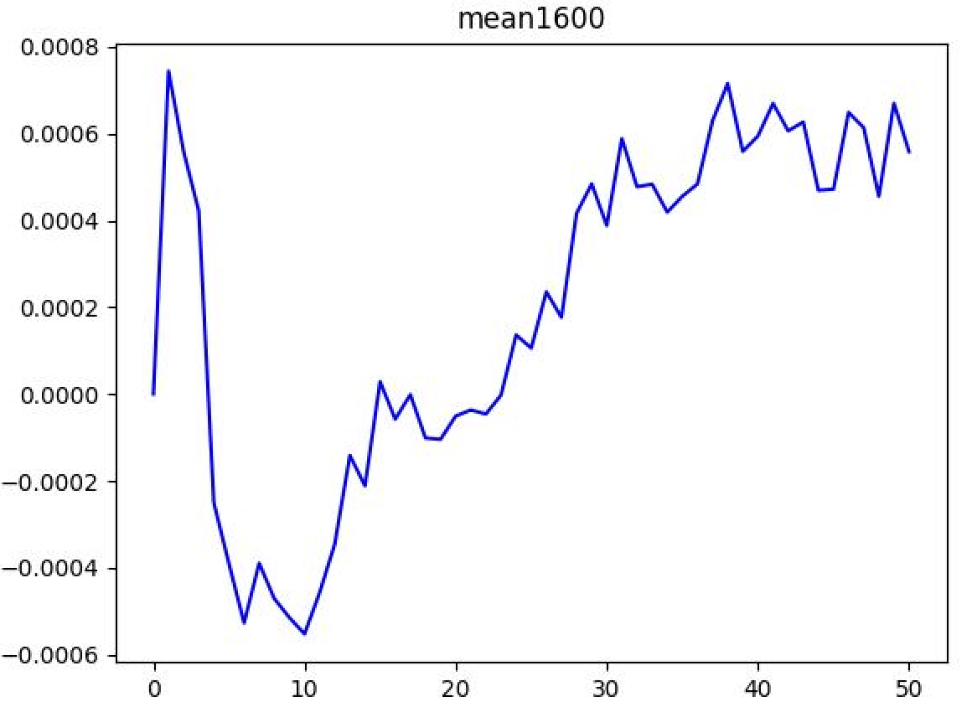
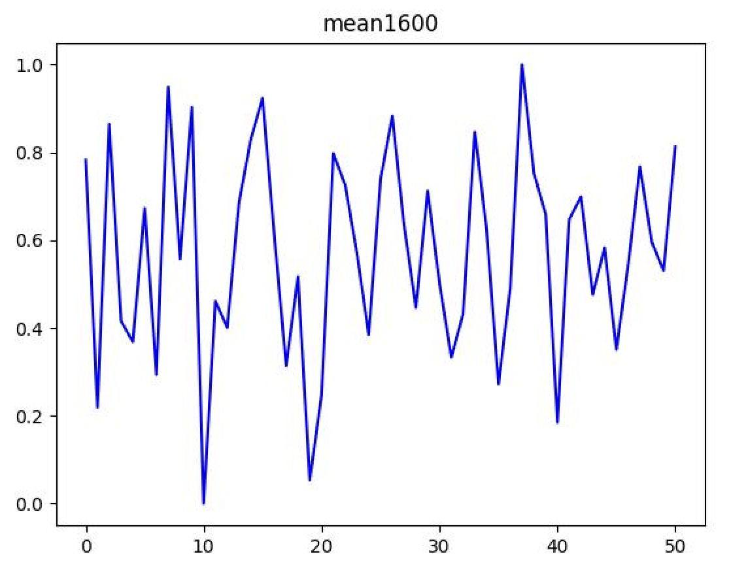
Computing the mean of memory vector
The original method to compute the mean
For the [9228,172] memory:
[a_{1,1},a_{1,2}, …, a_{1,172}]
[a_{2,1},a_{2,2}, …, a_{2,172}]
. . . .
. . . . [b₁, b₂, …, b₁₇₂]
. . . .
[a_{9228,1},a_{9228,2}, …, a_{9228,172}]
We compute the mean value in this way, then we can get a mean value of dimension [1,172].
Use t-SNE to reduce the dimension of mean value, and normalize it to [0,1], then plot.

